Slide 1
How Bad Has COVID-19 Been for the Stock Market?
By: Jacob Avchen, Jacob Hollander, and Salvatore Russo

Slide 2
Question 1:
Which Markets Have Been Most Negatively
Impacted by the Spread of COVID-19?
We examine a sampling of companies from different industries to determine which ones are being hit the hardest.
We broke our sample of 35 companies into 7 categories with 5 companies in each category to compare to each other. We also took data from 5 ETFs to get rough approximations of entire industries, and the DOW Jones Industrial Average and S&P 500 Indexes.
The following slides will show the hardest hit or most interesting industries to look at.

Slide 3
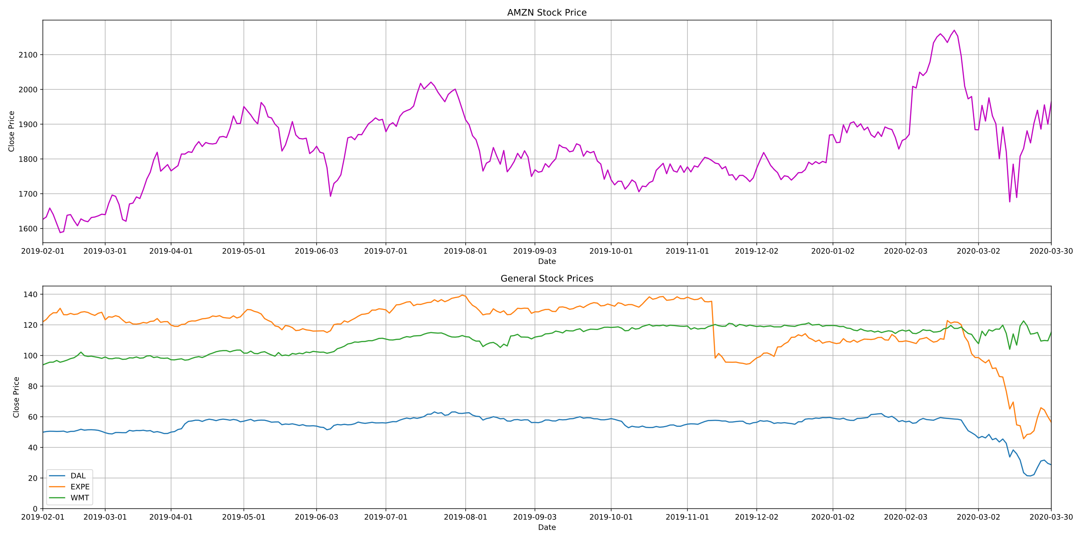
General Stocks

Slide 4
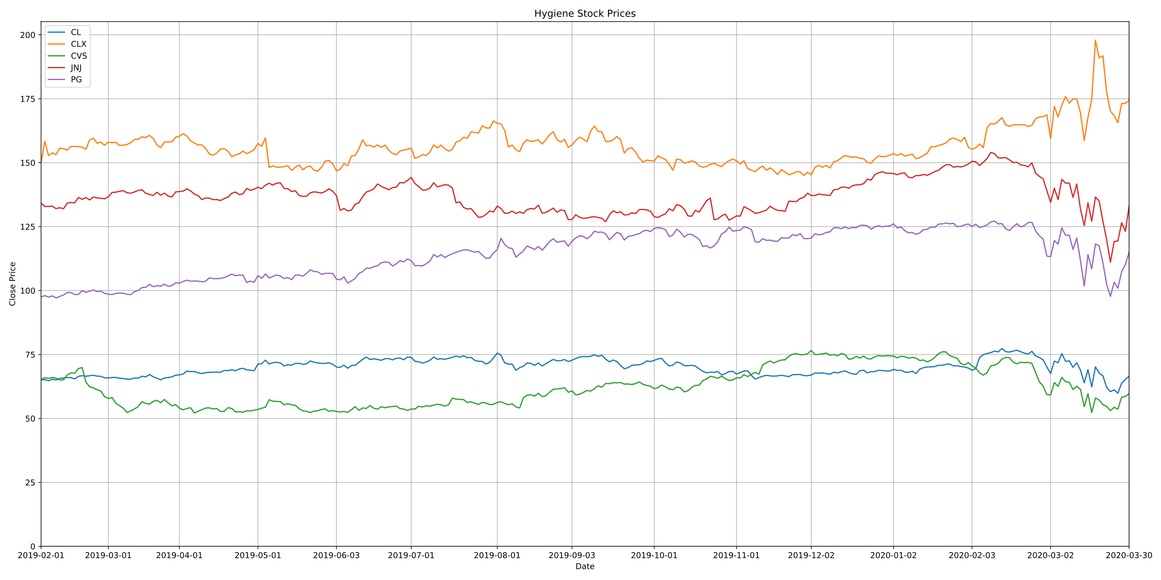
Hygiene Stocks

Slide 5
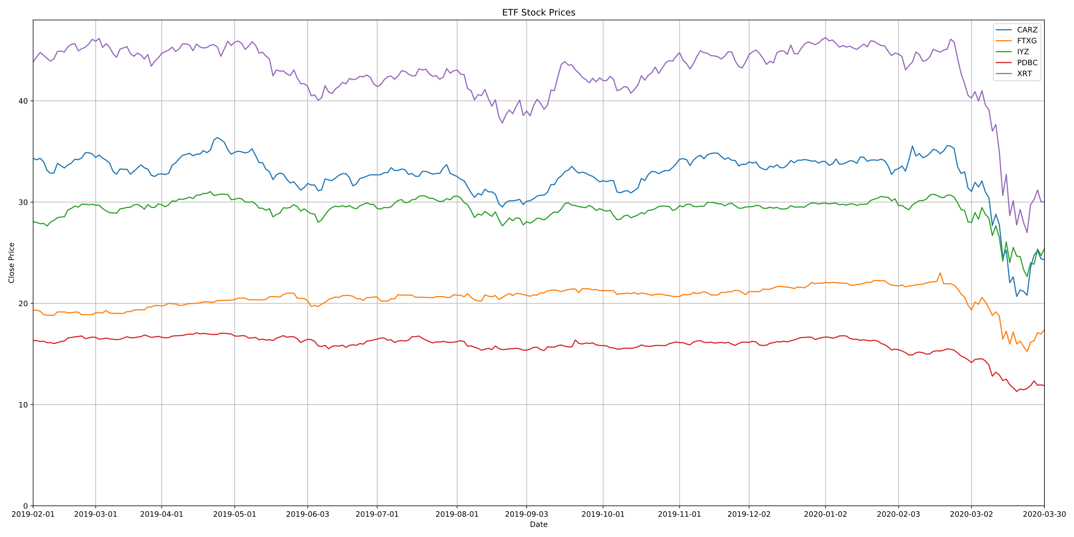
Industry ETFs
CARZ: Car Industry FTXG: Food & Beverage
IYZ: Telecommunications
PDBC: Commodities
XRT: Retail

Slide 6
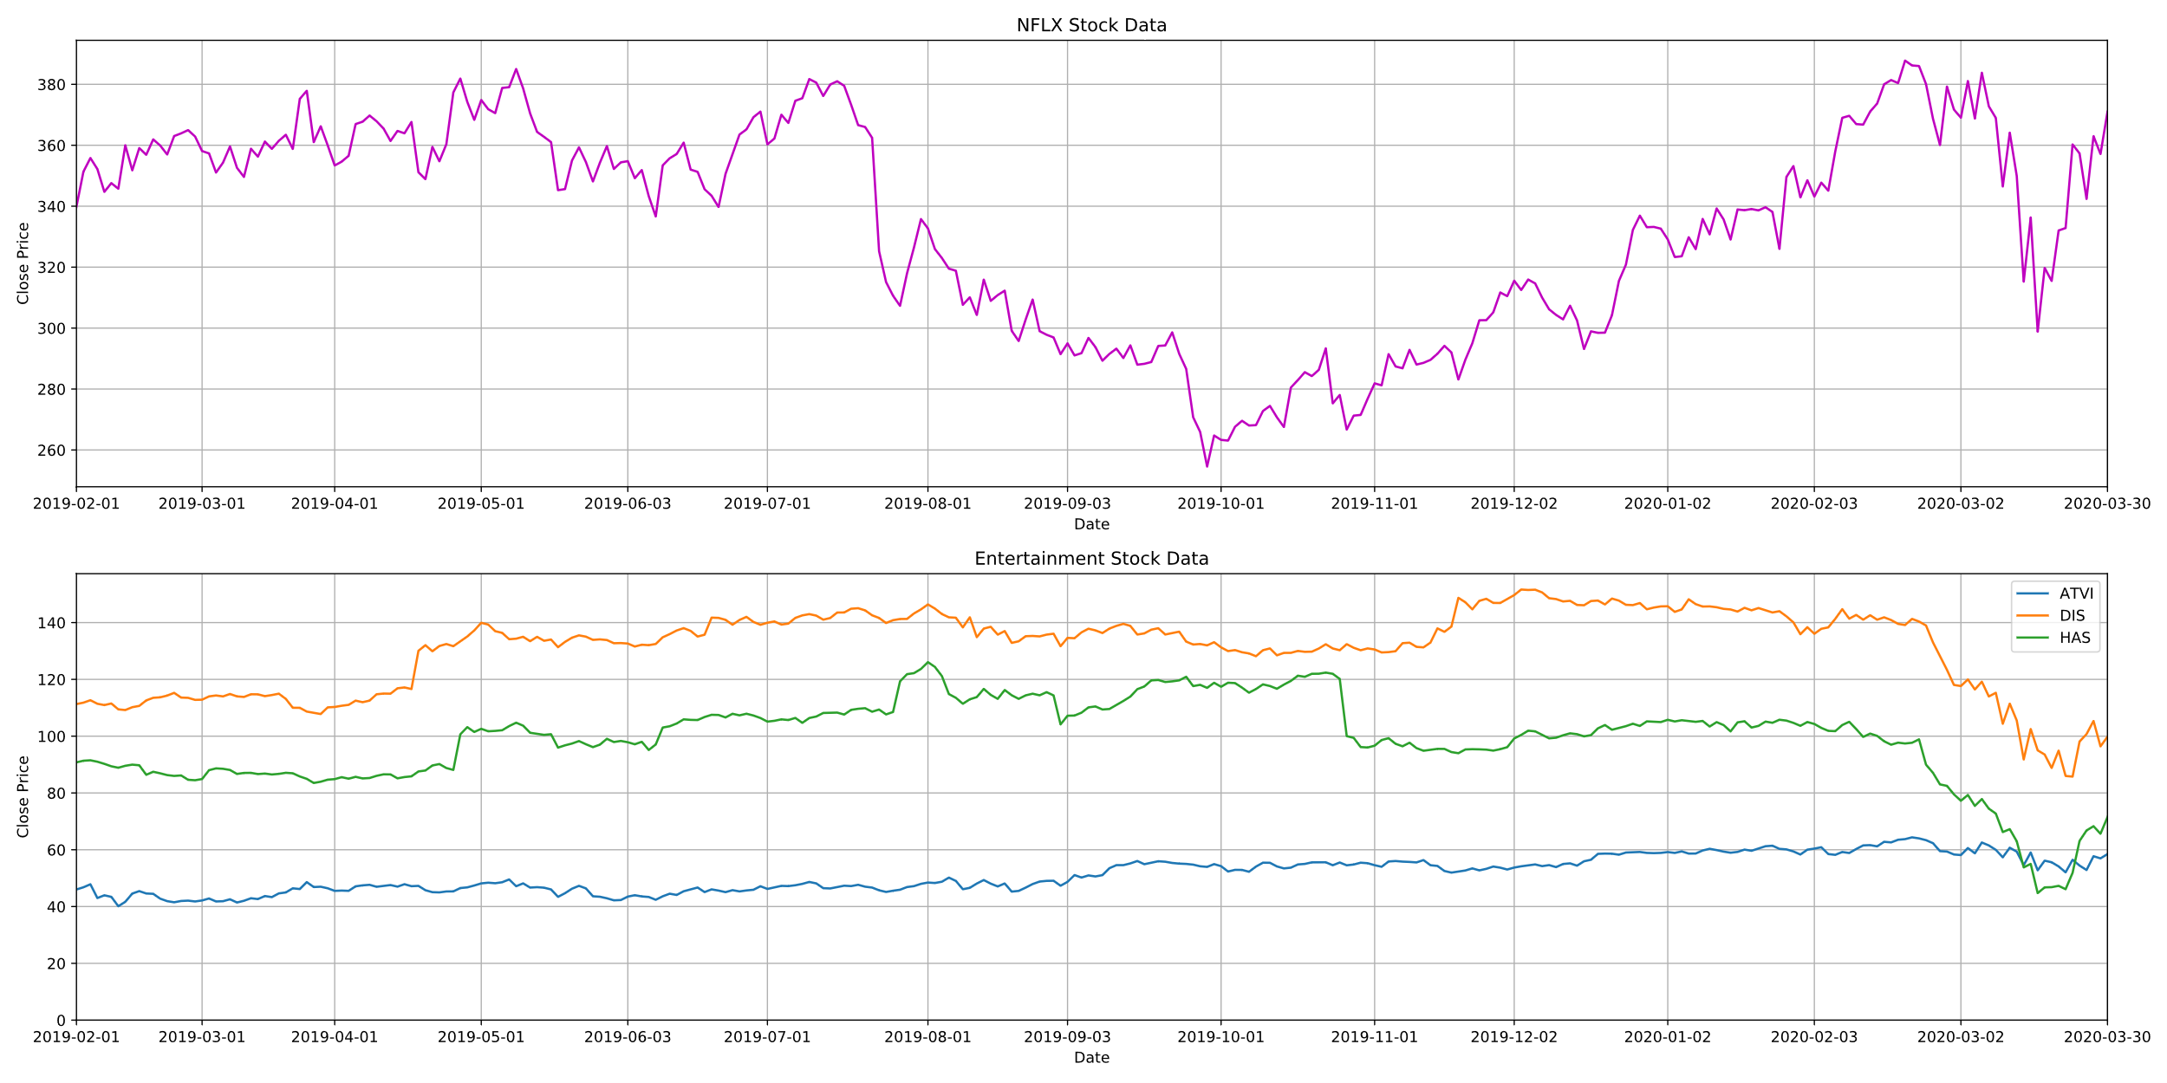
Entertainment Stocks

Slide 7
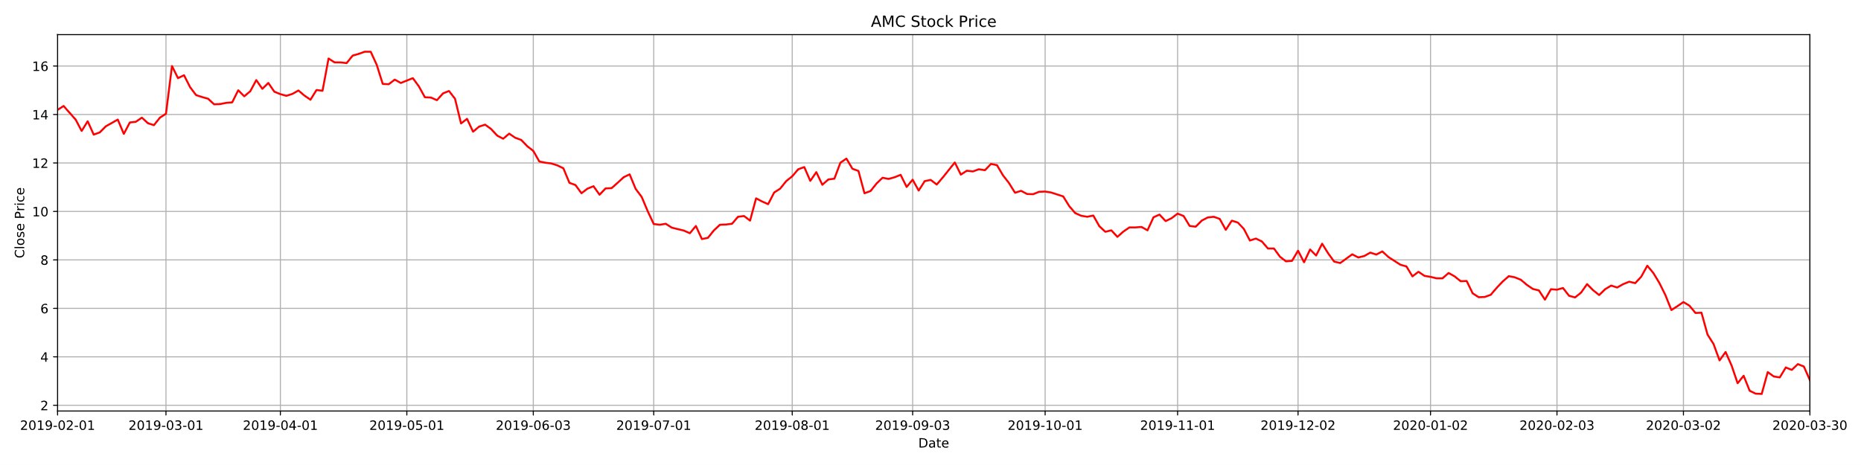
Netflix had a sharp decline, but bounced back quickly
Activision-Blizzard had almost no decline.
AMC went down to almost $2/stock compares to over $14/stock this time last year
Disney hit harder than anticipated given the popularity of Disney Plus

Slide 8
Conclusion
Unsurprisingly, retailers and the car industry took an enormous hit due to COVID-19.
Walmart, however, did not decline as much as anticipated.
Markets not shown behaved as expected, sharp declines mostly in mid March.
Clorox is the only stock we looked at that actually improved due to the pandemic, outperforming competitors.
The entertainment companies as a whole took less of a hit than anticipated.
Limitations
Low sample size
Somewhat limited API
Time

Slide 9
Question 2:
How do the Different Industry Averages Compare to the Market as a Whole during the crash caused by COVID-19?
We examine the sampling of 5 ETFs from different industries and compare them to the DOW Jones Industrial Average and S&P 500 Indexes to see their performance after the 2020 market crash caused by COVID-19. (2/20/20)
We will look at how the ETFs compare to the industrial averages as a whole. Some ETFs performed better than the industrial averages after the crash, and others performed worse.
We are looking at the automobile industry, the Food & Beverage industry, the Telecommunications industry, the Retail industry, and the Commodities industry.
The following slides will show how these ETFs compare to the DOW Jones Industrial Average and S&P 500 Indexes.

Slide 10
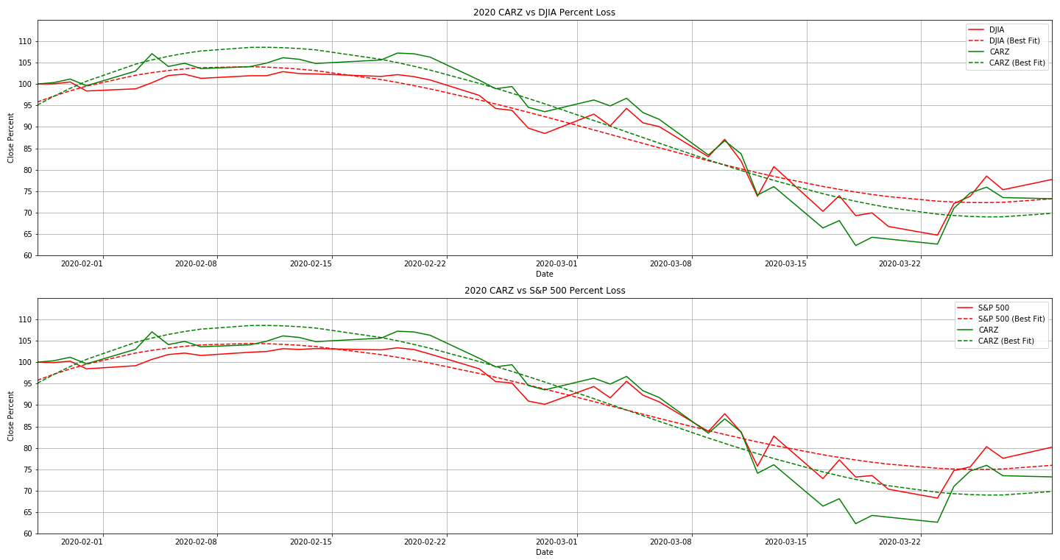
CARZ vs Dow Jones and S&P 500
(Automotive Industry)

Slide 11
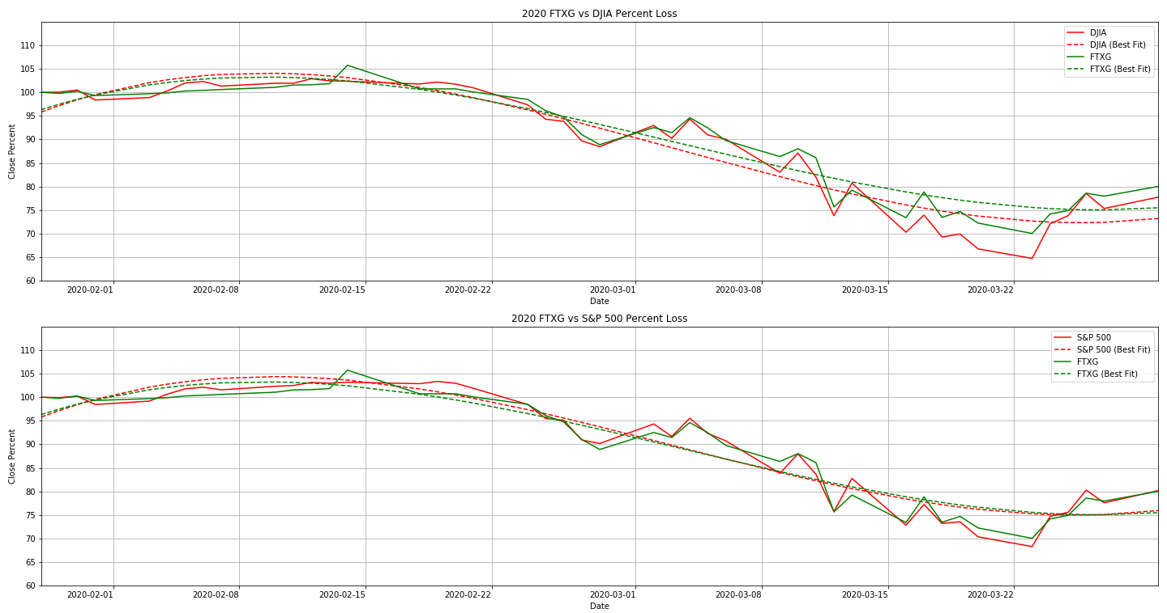
FTXG vs Dow Jones and S&P 500
(Food & Beverage)

Slide 12
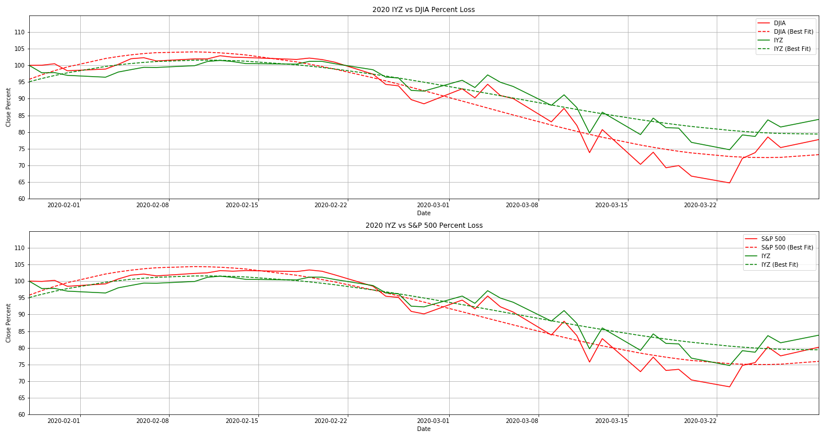
IYZ vs Dow Jones and S&P 500
(Telecommunications)

Slide 13
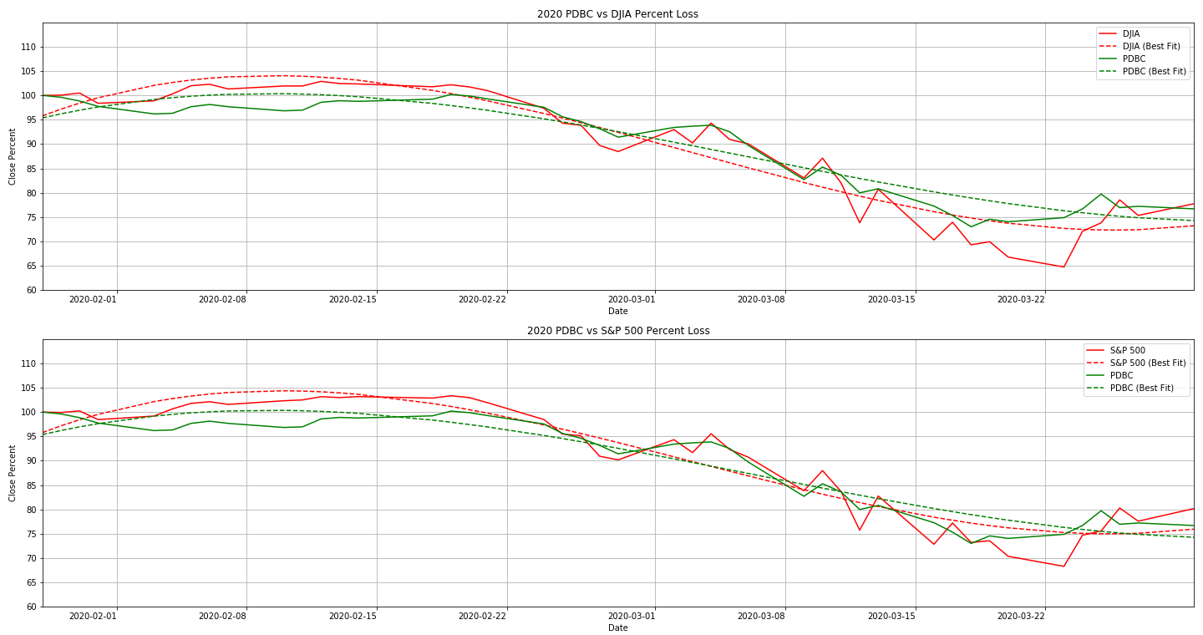
PDBC vs Dow Jones and S&P 500
(Commodities)

Slide 14
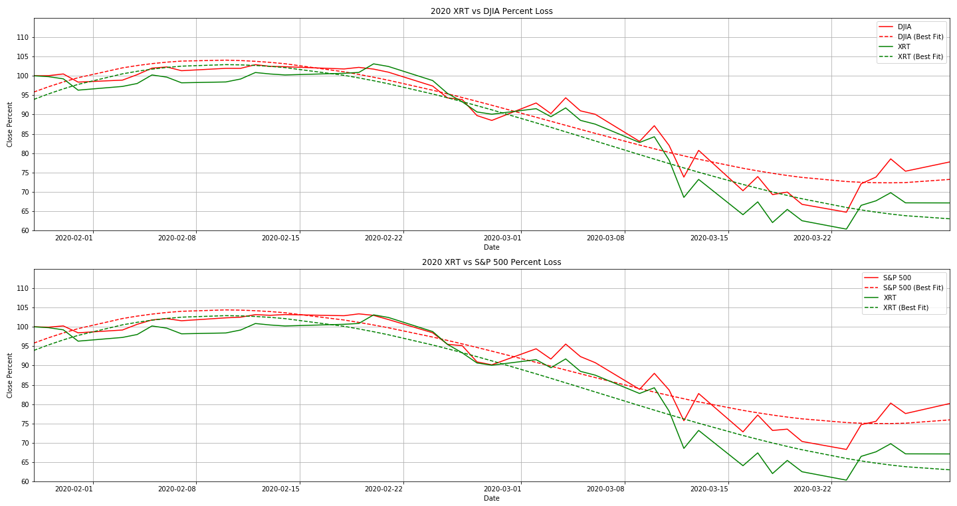
XRT vs Dow Jones and S&P 500
(Retail)

Slide 15
Conclusion
Most markets are performing similarly to the overall indexes.
The Automotive, Food & Beverage, and Commodities Industries/Stocks are performing about the same as the overall market. This isn’t much of a surprise, as some auto manufacturers are retro-fitting equipment to help with the pandemic.
Telecommunications is the only market that has outperformed the market since the crash.
The retail industry has been hit hard. With forced closures of non-essential businesses, and people unable to work, they will be focusing on purchasing only the essentials.
Limitations
Low sample size
Somewhat limited API
Time

Slide 16
Question 3:
How Does the Crash Caused by COVID-19
Compare to the Stock Market Crash of 2008?
*
*
*

